Slide 1
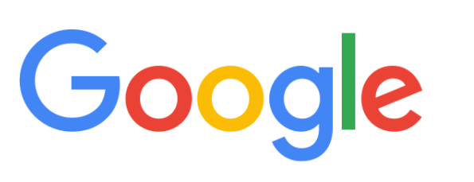
How Google search Works
Crawling
Indexing
Serving Search Results
Notes:
Google search works in three stages : 1 Crawling 2. Indexing ,3. Serving the results to end user

Slide 2


Crawling
Notes:
Many People,Companies and organization,universities make their websites ,as soon as they released or updated their website ; google comes into picture ,Google has automated programs which are looking for new or updated web pages over internet constantly .They will pick such pages and start analyzing it.Once they analyze second stage will come that is Indexing

Slide 3
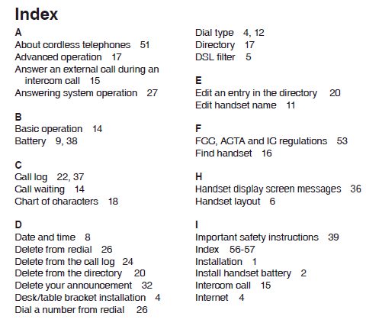
Indexing
Content
Images
Videos
Notes:
Google analyzes the content, images, and video files in the page, trying to understand what the page is about. This information is stored in the Google index, for analogy you can consider this index as similar as any back of the book index with an entry for every word seen on every webpage we index
,but in reality, it will be much more organized. The Google Search index contains hundreds of billions of webpages.

Slide 4
Serving Search Results
User's location
Language
Device (desktop or phone)
Previous queries
Notes:
Next stage is Serving the search result, when user search in google search ,Google tries to determine the highest relevance quality result ,This quality results are determine based on User location ,Language, Device and users previous search queries, if you search for Car repair shop ,you will find different results in India and in US.

Slide 5
Google doesn't accept payment to rank pages higher, and ranking is done algorithmically.

Slide 6


Replace
How to change light bulb
Exchange
Does post office change foreign currency
Meaning of query / Intent
Adjust
How to change brightness of TV
Notes:
To return relevant results for your query, Google first need to establish what information you’re looking forーthe intent behind your query. This ultimately means understanding the language. This involves interpreting the spelling mistake, Understanding the type of query .Establishing the relation between multiple words.
For example :You can see the different search queries with Same keyword means different and with different intent.

